Slide 1


SEEN: Social Entrepreneurship Ecosystems Network
XXII International Conference “Educational Technologies”
Sozopol, Bulgaria · 2026
An AI-Powered Chatbot Platform for Student Entrepreneurship Support in Higher Education
Design and Evaluation
Angel Marinov
Hristo Nenov
Technical University of Varna · a.marinov@tu-varna.bg
Funded by the European Union. Views and opinions expressed are however those of the author(s) only and do not necessarily reflect those of the European Union or the European Education and Culture Executive Agency (EACEA). Neither the European Union nor EACEA can be held responsible for them.

Slide 2



SEEN: Social Entrepreneurship Ecosystems Network
Why students need a better kind of support
The gap we set out to close
Entrepreneurship is a priority — but support doesn’t scale
Universities want to nurture student founders, yet one-to-one mentoring is scarce and unevenly available.
Students get stuck at every stage
From validating an idea to pitching it, they hit questions with no one on hand to ask.
Generic AI is available — but not trustworthy
Off-the-shelf chatbots are always on, yet they can be confidently wrong and aren’t grounded in real entrepreneurship knowledge.
Co-funded by the European Union · SEEN — Social Entrepreneurship Ecosystems Network (Erasmus+)

Slide 3

SEEN: Social Entrepreneurship Ecosystems Network
Our idea: a curated AI platform
Trustworthy guidance, available anytime
We built the SEEN AI Platform — a purpose-built assistant for student entrepreneurs that answers from a curated body of entrepreneurship knowledge, rather than the open internet.
Always available
Grounded & reliable
Curated. Conversational. Credible.
An AI assistant that behaves like a knowledgeable mentor — grounded in vetted material and focused on entrepreneurship.
Built for the student journey
seen.tu-varna.bg
Co-funded by the European Union · SEEN — Social Entrepreneurship Ecosystems Network (Erasmus+)

Slide 4





SEEN: Social Entrepreneurship Ecosystems Network
Five areas of support
One assistant across the whole journey
Idea Validation & Refinement
Business Model Guidance
Pitch Evaluation & Enhancement
Next-Step Recommendations
Resource Recommendations
Test and sharpen your startup concept.
Structure how your idea creates value.
Improve how you present your idea.
Know exactly what to do next.
Get the right tools and materials.
Co-funded by the European Union · SEEN — Social Entrepreneurship Ecosystems Network (Erasmus+)

Slide 5


SEEN: Social Entrepreneurship Ecosystems Network
How it works: curated, not generic
Retrieval-grounded answers from vetted content
Curated knowledge
Retrieve
AI composes
Grounded reply
Vetted entrepreneurship materials
Pull the most relevant content for the question
Generates an answer from that content
Trustworthy, on-topic guidance
The difference: generic chatbots improvise from the open web. SEEN answers from a curated knowledge base — so guidance stays accurate, relevant, and focused on entrepreneurship.
Co-funded by the European Union · SEEN — Social Entrepreneurship Ecosystems Network (Erasmus+)

Slide 6
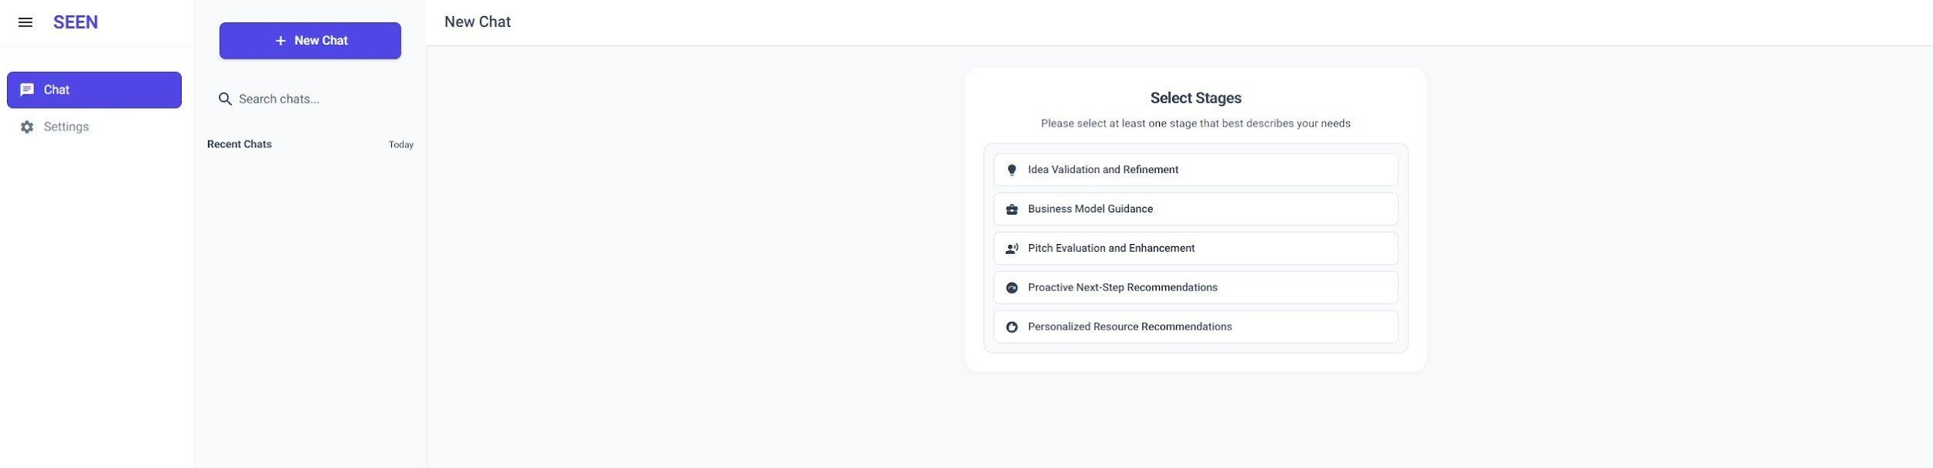
SEEN: Social Entrepreneurship Ecosystems Network
The platform in action
The student selects one of the five stages, then asks a question in plain language.
Clean, stage-based interface
Runs in any browser
Conversational — ask naturally
Co-funded by the European Union · SEEN — Social Entrepreneurship Ecosystems Network (Erasmus+)

Slide 7




SEEN: Social Entrepreneurship Ecosystems Network
From needs to deployment
How we designed and tested the platform
Needs analysis
1
Design
2
We looked at what students and educators actually need from such a tool.
We shaped the platform around those needs and curated its knowledge.
Build & deploy
3
Evaluation
4
We developed the assistant and put it live for real student use.
We trialled it with experts and students and gathered structured feedback.
Co-funded by the European Union · SEEN — Social Entrepreneurship Ecosystems Network (Erasmus+)

Slide 8



SEEN: Social Entrepreneurship Ecosystems Network
What we’re seeing
Early evaluation — qualitative signals
Positive reception
Reviewed by experts
Clear demand
Students found it useful, clear, and relevant to their needs.
Domain experts assessed the assistant and the quality of its guidance.
Strong appetite for grounded, stage-specific entrepreneurship support.
Note: detailed quantitative results are in preparation for a dedicated publication.
Co-funded by the European Union · SEEN — Social Entrepreneurship Ecosystems Network (Erasmus+)

Slide 9


SEEN: Social Entrepreneurship Ecosystems Network
Why it matters
Value on two sides
For students
For institutions
Guidance available any time, at their own pace
Answers grounded in real entrepreneurship knowledge
Support tailored to each stage of the journey
Scales entrepreneurship support beyond limited mentoring
Complements existing courses and programmes
Reusable across faculties and student cohorts
Co-funded by the European Union · SEEN — Social Entrepreneurship Ecosystems Network (Erasmus+)

Slide 10



SEEN: Social Entrepreneurship Ecosystems Network
What’s next
Wider rollout across partner institutions
Deeper evaluation and a forthcoming publication
Continuous refinement driven by user feedback
Co-funded by the European Union · SEEN — Social Entrepreneurship Ecosystems Network (Erasmus+)

Slide 11
SEEN: Social Entrepreneurship Ecosystems Network
Thank you
Questions and discussion welcome
Angel Marinov
Technical University of Varna
a.marinov@tu-varna.bg
Platform: seen.tu-varna.bg
Funded by the European Union. Views and opinions expressed are however those of the author(s) only and do not necessarily reflect those of the European Union or the European Education and Culture Executive Agency (EACEA). Neither the European Union nor EACEA can be held responsible for them.

