Slide 1



SEEN: Social Entrepreneurship
Ecosystems Network
AI-powered entrepreneurship
for societal wellbeing
Building Inclusive Deep-Tech Innovation Ecosystems
SEEN’s method: needs, guided AI and evaluation
Assoc. Prof. Angel Marinov
Technical University of Varna, Bulgaria
5th CloudEARTHi Conference, Ankara 7 October 2026 Panel opening
1
Co-funded by the European Union. Views and opinions expressed are those of the author(s) only and do not necessarily reflect those of the European Union or EACEA.
Neither the European Union nor EACEA can be held responsible for them.

Slide 2
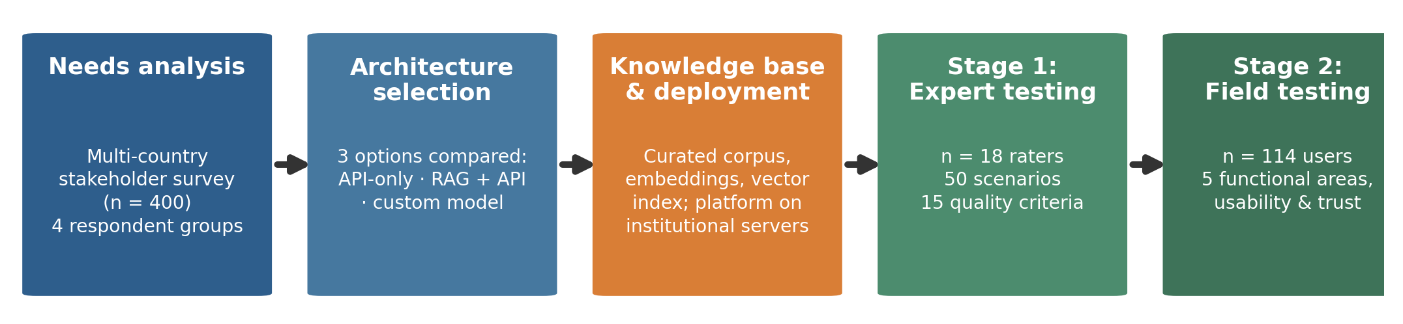
SEEN: Social Entrepreneurship
Ecosystems Network
The design and evaluation method
Each stage produces evidence for the next decision.
Needs shape the design. Testing identifies what to improve.
Source: SEEN design manuscript, Figure 1. Expert rubrics use seven assigned criteria per scenario from a battery of fifteen.
2
Co-funded by the European Union. Views and opinions expressed are those of the author(s) only and do not necessarily reflect those of the European Union or EACEA.
Neither the European Union nor EACEA can be held responsible for them.

Slide 3
SEEN: Social Entrepreneurship
Ecosystems Network
Needs become design requirements
A routed survey captured different stakeholder perspectives.
Evidence | Requirement | Design response
127 students wanted mentoring and networking, 28 received it | Support available when a learner needs it | Five structured entrepreneurship workflows
High AI use alongside limited formal preparation | Guidance that users can check | Relevant source passages linked to the response
Demand for practical use and critical AI literacy | Learning through use with visible limitations | Task-specific interaction and source checking
Design paper §§2.2, 3.1–3.4 and Table 2. Needs survey n=400, student subgroup n=271. Descriptive partner-recruited sample.
3
Co-funded by the European Union. Views and opinions expressed are those of the author(s) only and do not necessarily reflect those of the European Union or EACEA.
Neither the European Union nor EACEA can be held responsible for them.

Slide 4
SEEN: Social Entrepreneurship
Ecosystems Network
How the guidance uses knowledge
Retrieval-augmented generation (RAG)
1 Curate
Screen learning materials for relevance, licensing and personal data.
2 Retrieve
Find passages relevant to the user’s question and selected task.
3 Guide
Use those passages in the prompt and retain source links in the answer.
Institutions can inspect and update the knowledge base.
Design paper §§3.5–3.8. Selection considered relevance, traceability, data protection, effort and cost. Source links do not guarantee accuracy.
4
Co-funded by the European Union. Views and opinions expressed are those of the author(s) only and do not necessarily reflect those of the European Union or EACEA.
Neither the European Union nor EACEA can be held responsible for them.

Slide 5
SEEN: Social Entrepreneurship
Ecosystems Network
Two complementary evaluation methods
 | Expert test | Field test
Input | 50 predefined scenarios across five functions | Users work with their own ideas across the same five functions
Assessment | 18 raters apply fixed rubrics with seven criteria per scenario | 114 users rate their experience and provide written feedback
What it reveals | Quality against explicit criteria, with comparable scenario inputs | Usefulness and limitations in a more natural setting
Compare the pattern across methods, while keeping the samples separate.
Evaluation paper §§2.2–2.4. Expert coverage varied by scenario. User ratings concern perceived quality, not learning or venture impact.
5
Co-funded by the European Union. Views and opinions expressed are those of the author(s) only and do not necessarily reflect those of the European Union or EACEA.
Neither the European Union nor EACEA can be held responsible for them.

Slide 6
SEEN: Social Entrepreneurship
Ecosystems Network
A diagnostic example: pitch feedback
Observed in both tests
Proposed test of that explanation
Pitch feedback ranked lowest.
Experts: 3.20/5 Users: 3.32/5
1 Define the pitch-quality rubric
2 Generate weak-to-improved examples
A possible explanation
3 Have experts validate the examples
The knowledge base may contain
too few worked pitch examples.
Prompting or model limits may also matter.
4 Add them and repeat the evaluation
Evaluation paper §§3.1–3.2 and 4.1–4.2. Scores are separate descriptive means. The explanation and intervention remain untested.
6
Co-funded by the European Union. Views and opinions expressed are those of the author(s) only and do not necessarily reflect those of the European Union or EACEA.
Neither the European Union nor EACEA can be held responsible for them.

Slide 7
SEEN: Social Entrepreneurship
Ecosystems Network
Applying the method to inclusion
Proposed extension for deep-tech entrepreneurship and societal value
Whose needs?
Include people beyond existing networks when defining the problem.
Which guidance?
Test sector-specific content and its connection to specialist support.
Which outcomes?
Assess decisions, participation and benefits defined with communities.
Adapt the support, then repeat the evaluation in the new context.
Panel briefing questions 1–6, informed by SEEN’s design and evaluation method. These extensions are proposals, not measured SEEN impacts.
7
Co-funded by the European Union. Views and opinions expressed are those of the author(s) only and do not necessarily reflect those of the European Union or EACEA.
Neither the European Union nor EACEA can be held responsible for them.

Slide 8
SEEN: Social Entrepreneurship
Ecosystems Network
A method the ecosystem can build on
Needs give the design a rationale.
Structured testing reveals where guidance falls short.
Adaptation creates a new question for evaluation.
Opening question for our panel
What should societal wellbeing mean when we choose
which ventures to support?
8
Co-funded by the European Union. Views and opinions expressed are those of the author(s) only and do not necessarily reflect those of the European Union or EACEA.
Neither the European Union nor EACEA can be held responsible for them.

